Slide 1
Cycles

Slide 2
Water Cycle

Slide 3
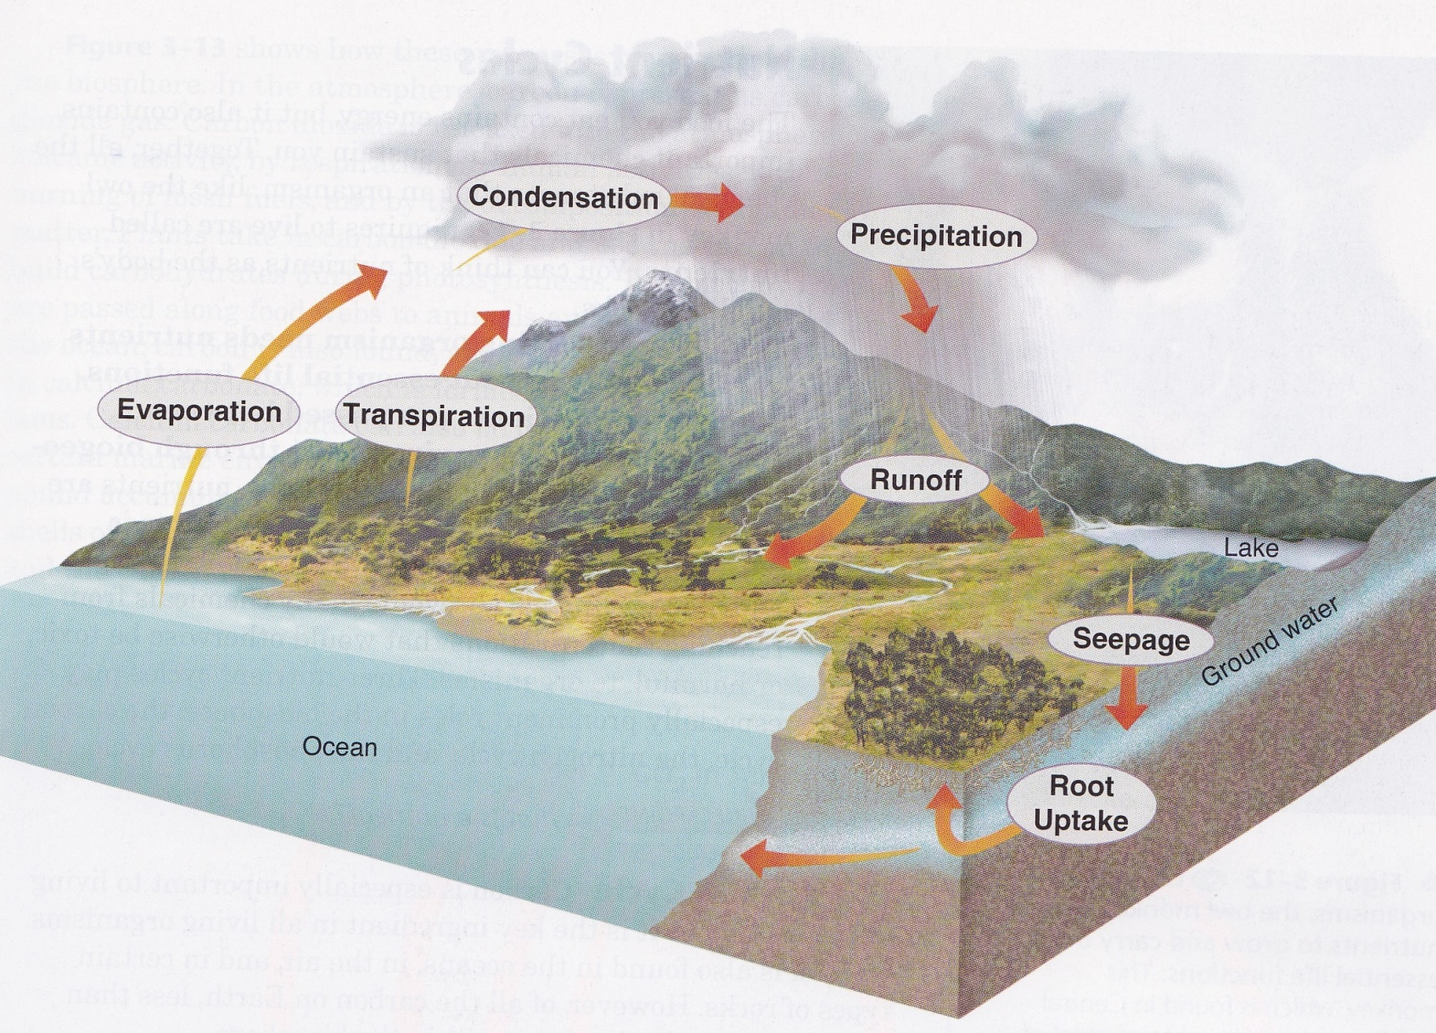
Water Cycle
Evaporation
Water changing into gas
Happens on the surface of a liquid
Transpiration
Water changing into gas
Happens from leaves of plants
Condensation
Gas changing into liquid
Precipitation
Rain from clouds

Slide 4
Water Cycle
Runoff
Water running down surface to river/stream
Seepage
Water going into soil
Root Uptake
Water entering plants through roots

Slide 5
Carbon Cycle

Slide 6
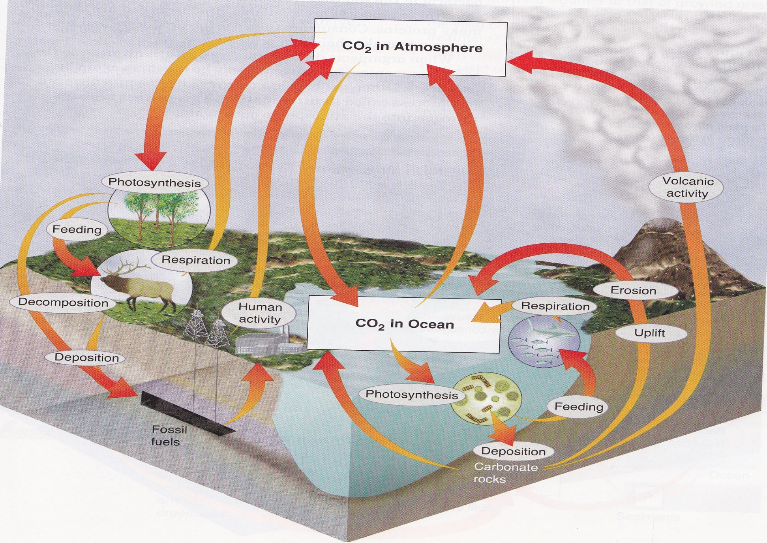
Carbon Cycle
LAND
Photosynthesis
Carbon becomes carbohydrates (ORGANIC)
Feeding
Animals digest carbohydrates
Respiration & Human Activity
Release CO2 into atmosphere
Carbon becomes INORGANIC
Decomposition
Dead animals decompose
Deposition
Build up of organic matter
Fossil Fuels
Burned by humans

Slide 7
Carbon Cycle
OCEAN
Photosynthesis
Carbon becomes carbonate (ORGANIC)
Feeding
Animals digest carbonates
Respiration & Erosion
Release CO2 back into atmosphere through ocean
Deposition
Carbonates build up on ocean floor
Uplift
Earth movement releases CO2 gases
Volcanic Activity
Releases CO2 into atmosphere
Carbon becomes INORGANIC

Slide 8
Nitrogen Cycle

Slide 9
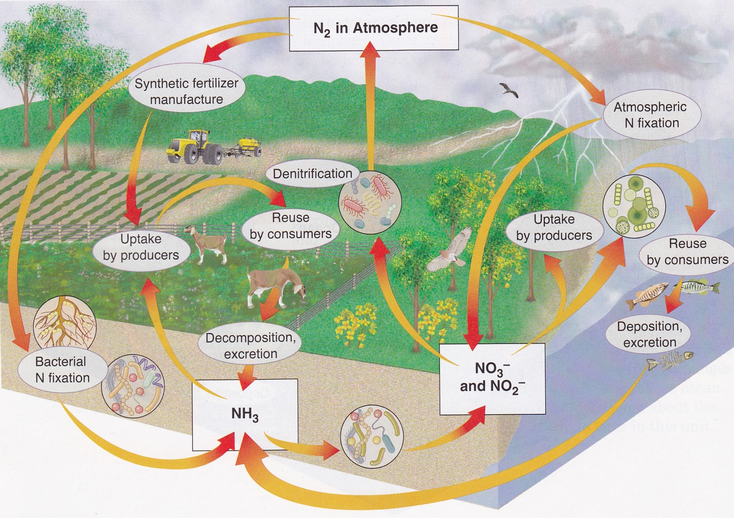
Nitrogen Cycle
Synthetic Fertilizer Manufacture
Nitrogen gas used to make fertilizer
Uptake by Producers
Take in nitrogen to produce proteins
Use nitrates/nitrites to make proteins
Reuse by Consumers
Reuse nitrogen from producers

Slide 10
Nitrogen Cycle
Decomposition/Deposition and Excretion
Dead animals/waste converted to ammonia (NH3)
Bacterial Nitrogen Fixation
Bacteria convert nitrogen into ammonia (NH3)
Atmospheric Nitrogen Fixation
Atmosphere converts nitrogen into nitrates/nitrites
Denitrification
Bacteria converts NO3/NO2 into nitrogen gas
NH3 converted into Nitrates/Nitrites (NO3/NO2) by bacteria in soil

